Slide 1

Rockbuster Stealth
Andrew Armstrong – data analyst

Slide 2
Key questions
Where are our customers located?
How much revenue do our top countries bring in?
What genres are selling best?
Defining and answering these questions will allow us to better inform our business decisions for the upcoming quarter and beyond. This will drive sales and allow us to further expand our market, gaining the edge on our competitors.

Slide 3
Data overview
Rental Rate
Minimum: $0.99
Maximum: $4.99
Average: $2.98
Rental Length
Minimum: 46 Minutes
Maximum: 185 Minutes
Average: 115 Minutes
Rental Duration
Minimum: 3 Days
Maximum: 7 Days
Average: 5 Days

Slide 4
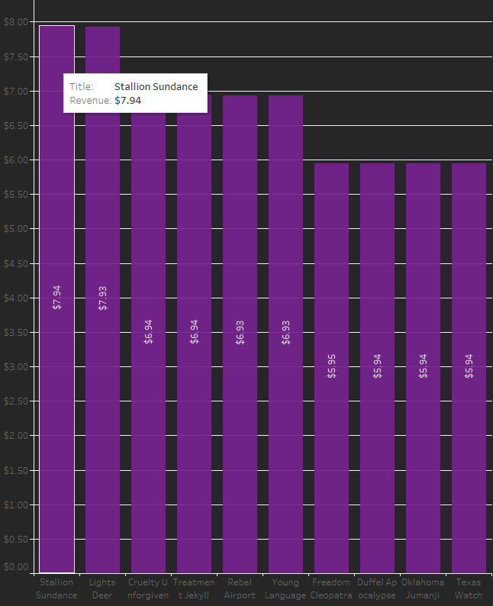
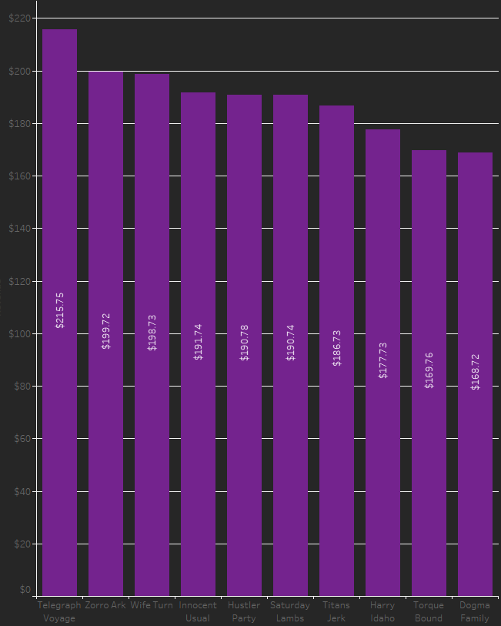
Highest and Lowest grossing movies
It is always a good idea to start by looking at what is working and what is not. Here we see our top performers (right) as well as our lowest performers (left) as well as how much revenue they are generating.

Slide 5
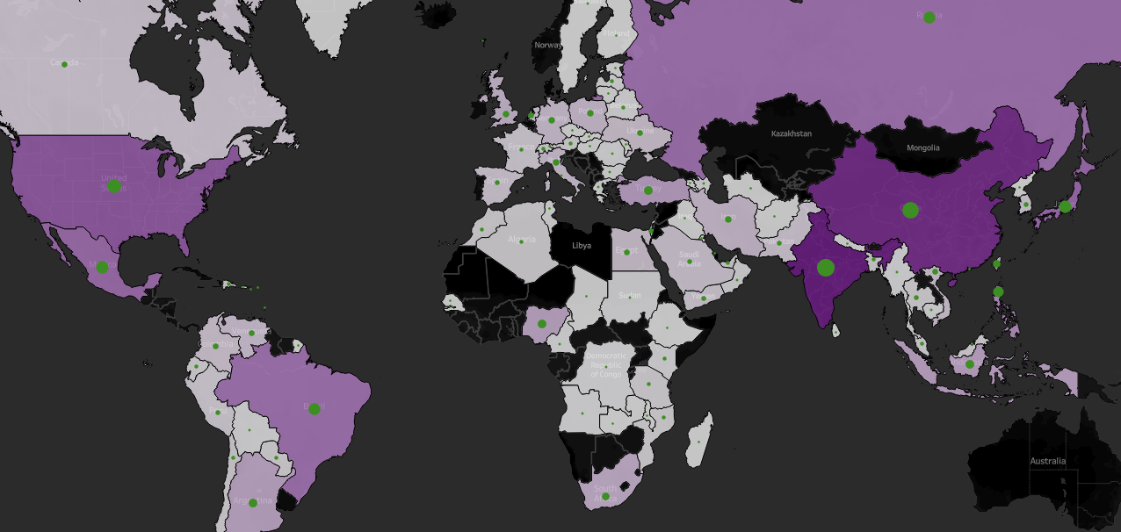
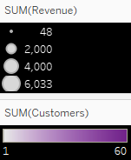
The world by population and revenue

Slide 6
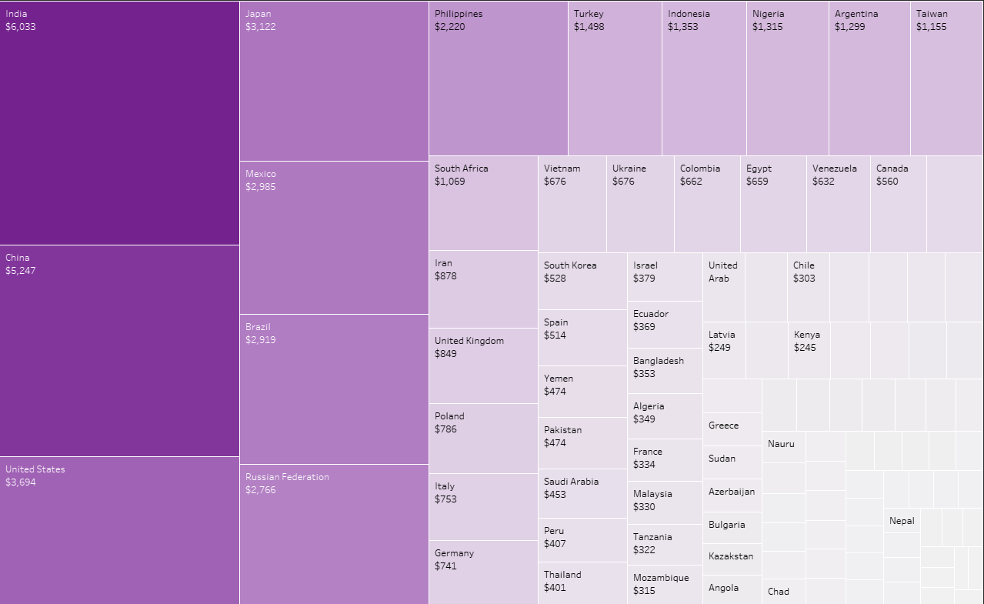
Findings
Simplifying our previous graphic, we can see which countries are performing the best, but we still have one more question.
What is selling in these top regions?

Slide 7
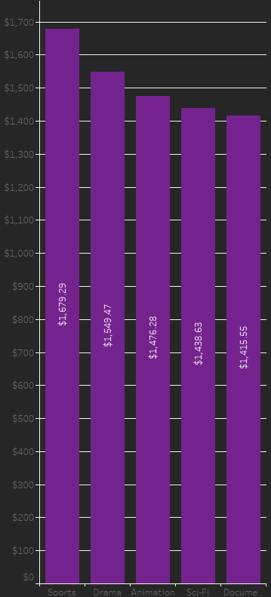
Top selling genres
Taking our top 5 countries into account, I was able to pull the most popular genres in order along with their respective profits. This gives us valuable insight into where and
What kind of sales we need to be driving to see an increase in profits.

Slide 8

Conclusions and recommendations
Remove the bottom percentage of movies producing the lowest amount of revenue
Focus on your major markets (India, China, US, Japan, and Mexico)
Increase inventory on popular genres (Sports, Drama, Animation, Sci-fi, and Documentaries )

